Slide 1
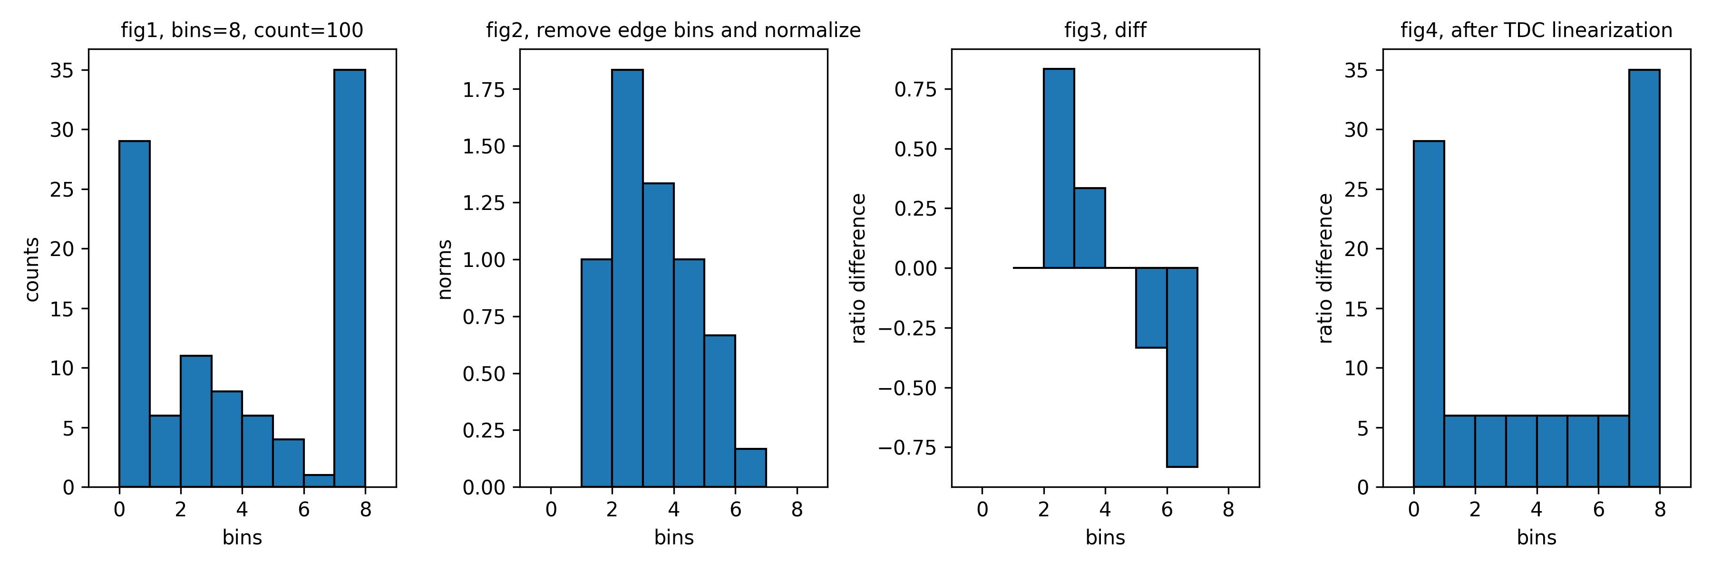
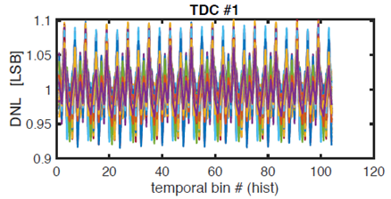


Lens Calibration
Jasper Calibration BM process
Dark Box
LPFF
Rail
P2P
$t_{0}$ measure
Spot finding
TDC Cal.
Geo Cal.
Depth Cal.
FPN Cal.
LPFF TDC Linearization
Python code for TDC linearization
Definition of Differential Non-Linearity
11
11
Ideal TDC
Conventional TDC
$$DNL\left(11\right)=0 LSB$$
10
10
$$DNL\left(10\right)=−0.3 LSB$$
01
01
00
V (LSB)
00
$$DNL\left(01\right)=0.5 LSB$$
V (LSB)
Jasper의 DNL 측정값 DNL $∈$ [0.71, 1.66] 일 때 양품 판정. 통상적으로 [0.8, 1.2] in Jasper case
$$DNL\left(00\right)=−0.2 LSB$$
일정
22.06
22.07
22.08
22.09
EVK, POC 수령
LFPP/P2P
광원 및 광학계
검토
Dark box 및
Chart 구현
검토
IMX459 EVK을
활용하여
LPFF/P2P 검증
IMX459 EVK을
활용하여
Dark box 검증
IMX459 EVK을
활용하여
Chart/Rail 검증
결과 종합 및
장비화 컨셉 검토

Slide 2




Lens Calibration
Summarized Lens Calibration process
Print a pattern and attach it to a planar surface.
Take several images with different locations and orientations by moving either the plane or camera.
Detect the corners of the chessboard.
Estimate intrinsic and extrinsic parameters.
Refine the found parameters.
Obtain the distortion parameters.
Repeat 4~6 until all the parameters converge.
$←$ Corner detector algorithm.
$←$ Zhang’s technique.
$←$ The Levenberg-Marquardt algorithm.
$←$ The Brown-Conrady model.

Slide 3


고객가치
새로운 시도
집요한 실행
The Brown-Conrady Model

Slide 4
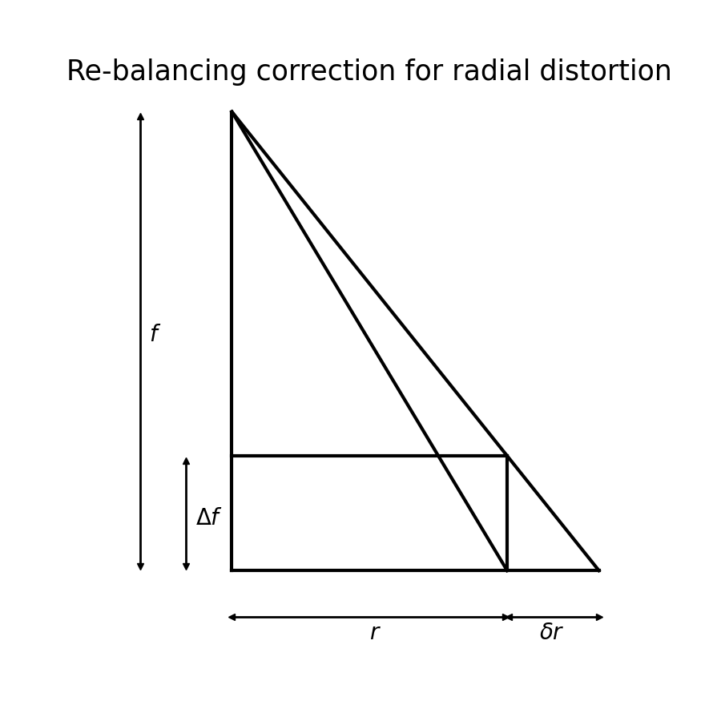


Lens Calibration
$$r=\sqrt{x^{2}+y^{2}}$$
$$δr=k_{1}r^{3}+k_{2}r^{5}+k_{3}r^{7}+…+k_{n}r^{n+2}$$
In practice, $k_{1},k_{2}$ and $k_{3}$ are typically used.

Slide 5
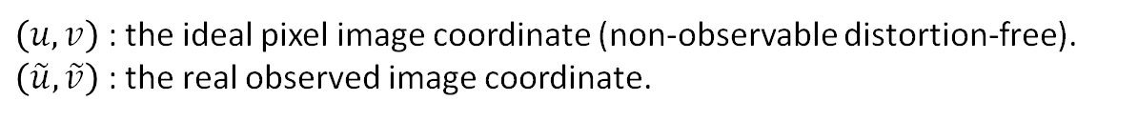
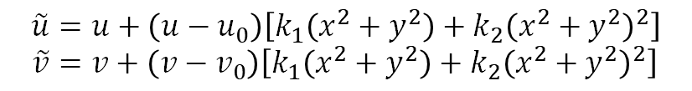
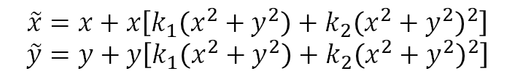
Lens Calibration
Dealing with radial distortion
$\left(x,y\right)$ : the ideal normalized image coordinate (non-observable distortion-free).
$\left(\tilde{x},\tilde{y}\right)$ : the real observed normalized image coordinate.
$$\tilde{x}=x+x\left[k_{1}\left(x^{2}+y^{2}\right)+k_{2}{\left(x^{2}+y^{2}\right)}^{2}\right] \\ \tilde{y}=y+y\left[k_{1}\left(x^{2}+y^{2}\right)+k_{2}{\left(x^{2}+y^{2}\right)}^{2}\right]$$
$\left(u,v\right)$ : the ideal pixel image coordinate (non-observable distortion-free).
$\left(\tilde{u},\tilde{v}\right)$ : the real observed image coordinate.
Assuming $γ=0$, from $\tilde{u}=u_{0}+α\tilde{x}+γ\tilde{y}$ and $\tilde{v}=v_{0}+β\tilde{y}$
$$\tilde{u}=u+\left(u−u_{0}\right)\left[k_{1}\left(x^{2}+y^{2}\right)+k_{2}{\left(x^{2}+y^{2}\right)}^{2}\right] \\ \tilde{v}=v+\left(v−v_{0}\right)\left[k_{1}\left(x^{2}+y^{2}\right)+k_{2}{\left(x^{2}+y^{2}\right)}^{2}\right]$$

Slide 6
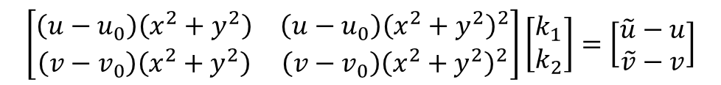
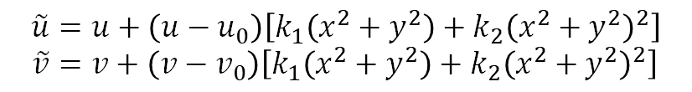


Lens Calibration
Dealing with radial distortion
$$\tilde{u}=u+\left(u−u_{0}\right)\left[k_{1}\left(x^{2}+y^{2}\right)+k_{2}{\left(x^{2}+y^{2}\right)}^{2}\right] \\ \tilde{v}=v+\left(v−v_{0}\right)\left[k_{1}\left(x^{2}+y^{2}\right)+k_{2}{\left(x^{2}+y^{2}\right)}^{2}\right]$$
$$\left[\begin{matrix}\left(u−u_{0}\right)\left(x^{2}+y^{2}\right) & \left(u−u_{0}\right){\left(x^{2}+y^{2}\right)}^{2} \\ \left(v−v_{0}\right)\left(x^{2}+y^{2}\right) & \left(v−v_{0}\right){\left(x^{2}+y^{2}\right)}^{2}\end{matrix}\right]\left[\begin{matrix}k_{1} \\ k_{2}\end{matrix}\right]=\left[\begin{matrix}\tilde{u}−u \\ \tilde{v}−v\end{matrix}\right]$$
$$Dk=d$$
$$k={\left(D^{T}D\right)}^{−1}D^{T}d$$

Slide 7
고객가치
새로운 시도
집요한 실행
Corner detector

Slide 8
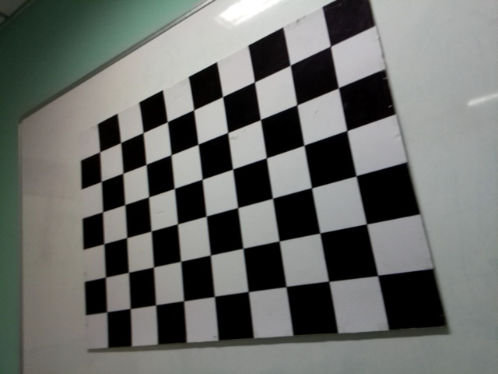
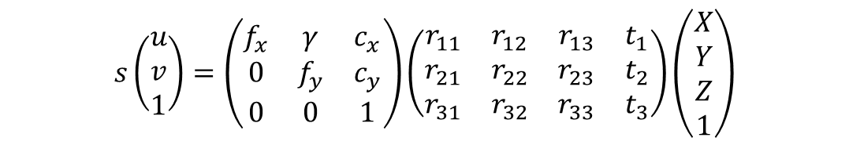
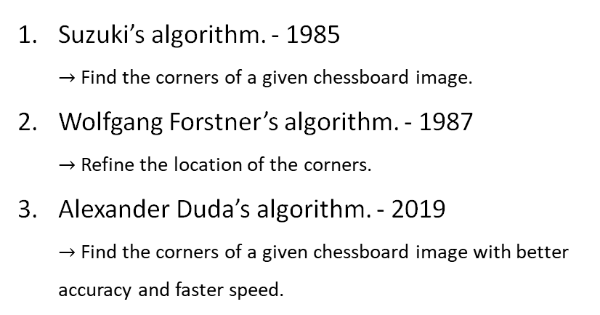

Lens Calibration
Pinhole camera equation
intrinsic
extrinsic
$$s\left(\begin{aligned}u \\ v \\ 1\end{aligned}\right)=\left(\begin{matrix}f_{x} & γ & c_{x} \\ 0 & f_{y} & c_{y} \\ 0 & 0 & 1\end{matrix}\right)\left(\begin{matrix}r_{11} & r_{12} & r_{13} & t_{1} \\ r_{21} & r_{22} & r_{23} & t_{2} \\ r_{31} & r_{32} & r_{33} & t_{3}\end{matrix}\right)\left(\begin{aligned}X \\ Y \\ Z \\ 1\end{aligned}\right)$$
$u$ and $v$ are must be well-defined to accurately calibrate the camera.
640 pixels
Suzuki’s algorithm. - 1985 $→$ Find the corners of a given chessboard image.
Wolfgang Forstner’s algorithm. - 1987 $→$ Refine the location of the corners.
Alexander Duda’s algorithm. - 2019 $→$ Find the corners of a given chessboard image with better accuracy and faster speed.
$$\left(u_{i},v_{i}\right)$$
480 pixels

Slide 9
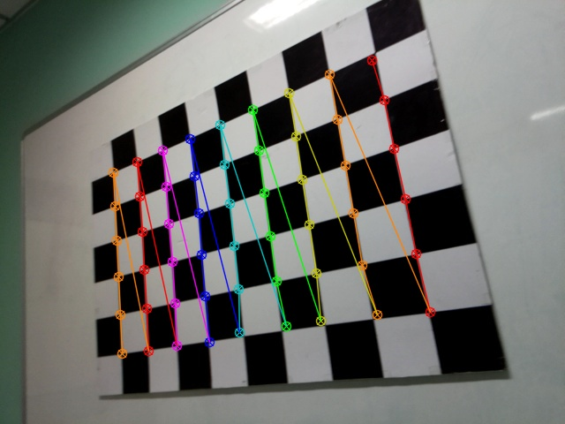

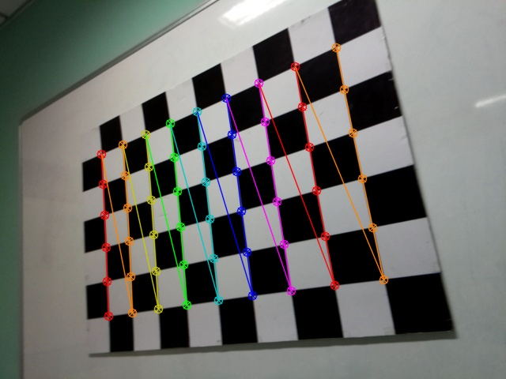

Lens Calibration
Suzuki’s algorithm
Suzuki’s + Forstner’s algorithm
Alexander Duda’s algorithm
Alexander + Forstner’s algorithm

Slide 10
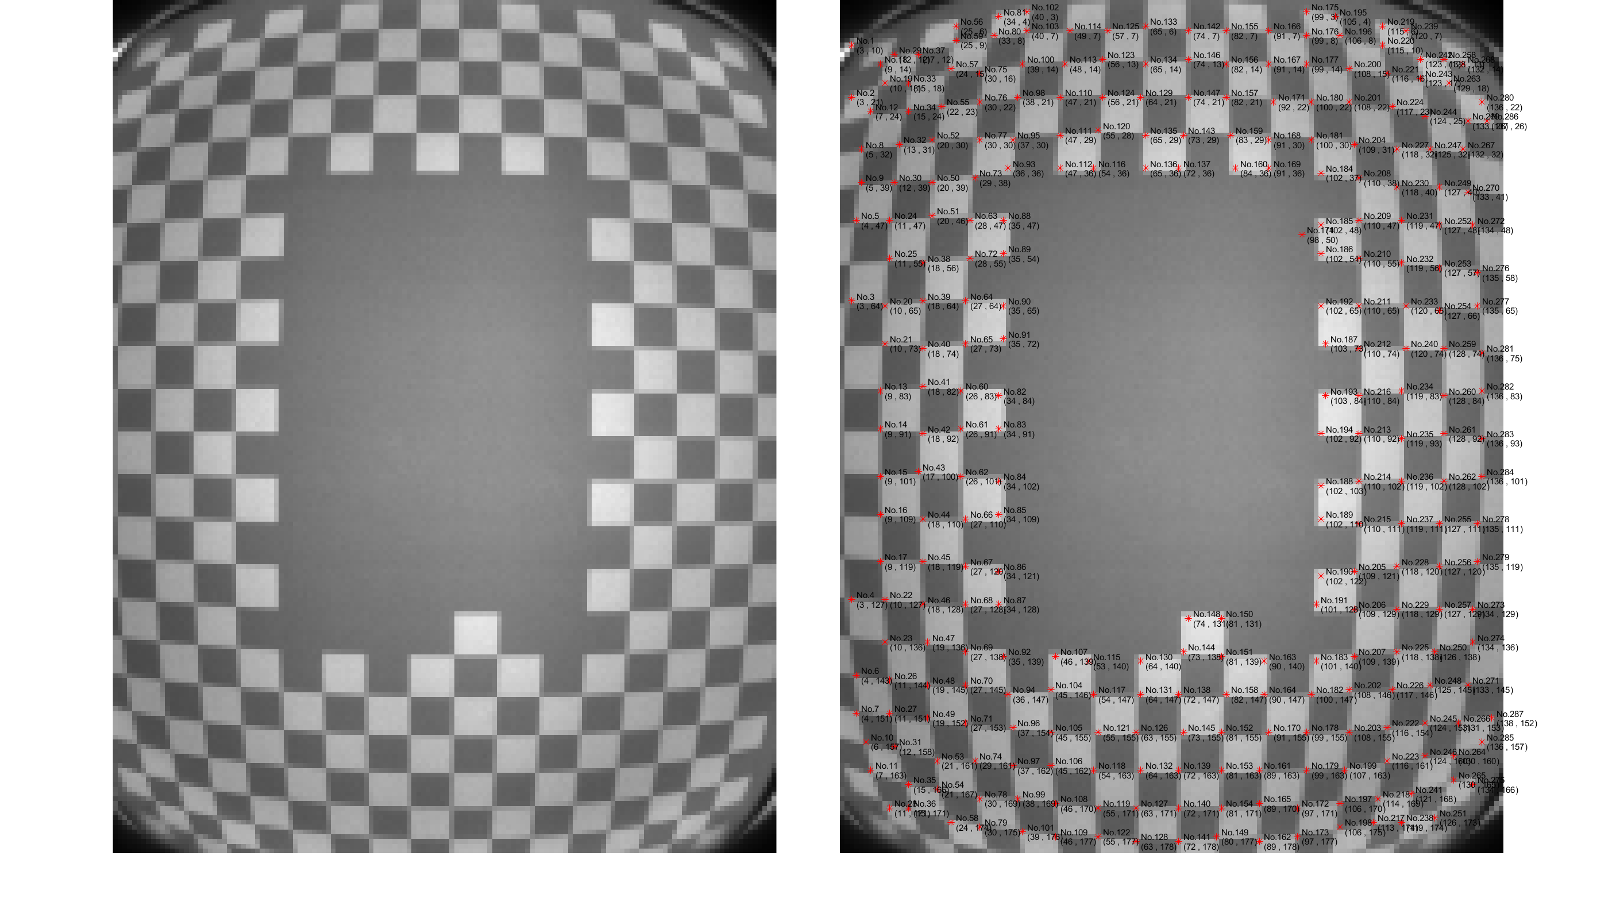

Lens Calibration
Lens Calibration in Jasper
Point localizing by hand $→$ of no uses.
100cm

Slide 11
Lens Calibration
Alexander Duda’s algorithm

Slide 12
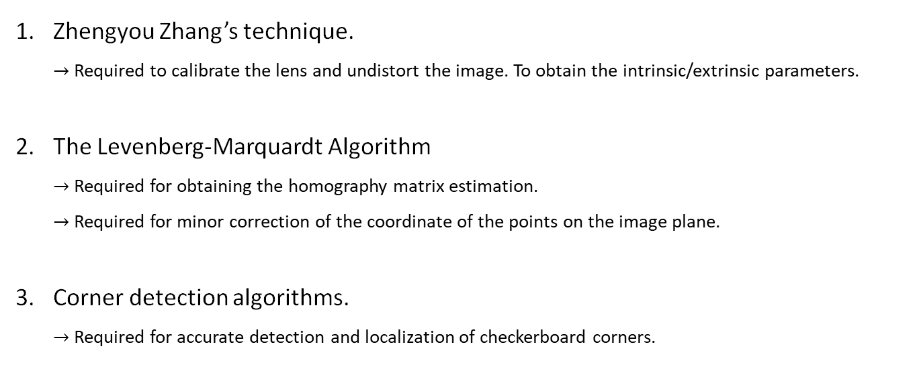
Lens Calibration
Algorithm required for Lens calibration
Zhengyou Zhang’s technique. $→$ Required to calibrate the lens and undistort the image. To obtain the intrinsic/extrinsic parameters.
The Levenberg-Marquardt Algorithm $→$ Required for obtaining the homography matrix estimation. $→$ Required for minor correction of the coordinate of the points on the image plane.
Corner detection algorithms. $→$ Required for accurate detection and localization of checkerboard corners.

Slide 13
Lens Calibration
Algorithm required for Lens calibration
Zhengyou Zhang’s technique. $→$ Required to calibrate the lens and undistort the image. To obtain the intrinsic/extrinsic parameters.
The Levenberg-Marquardt Algorithm $→$ Required for obtaining the homography matrix estimation. $→$ Required for minor correction of the coordinate of the points on the image plane.
Corner detection algorithms. $→$ Required for accurate detection and localization of checkerboard corners.

Slide 14

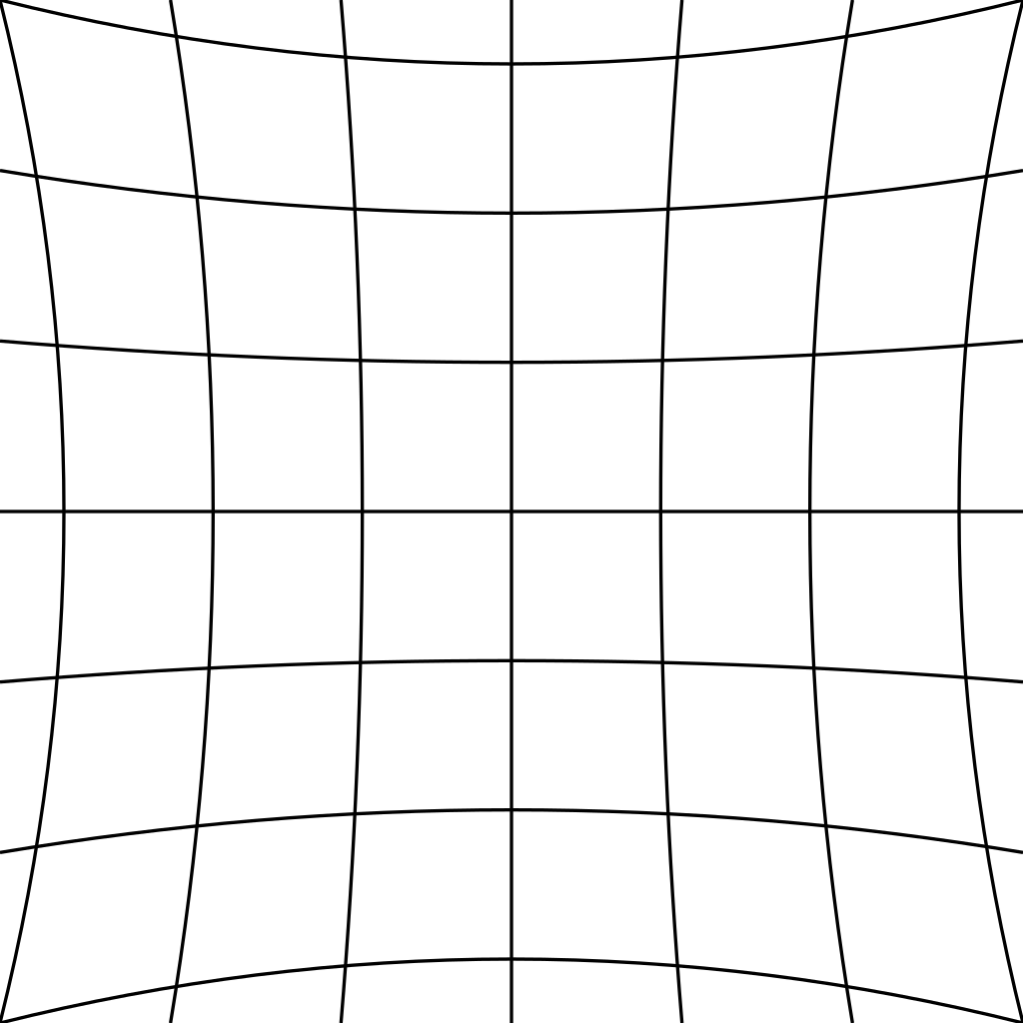
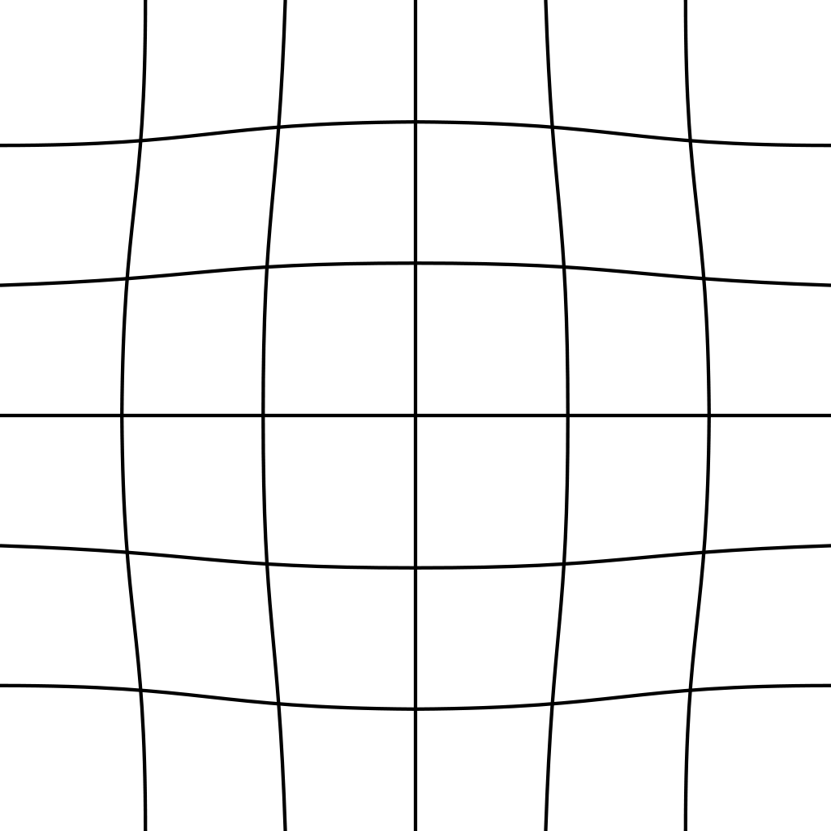
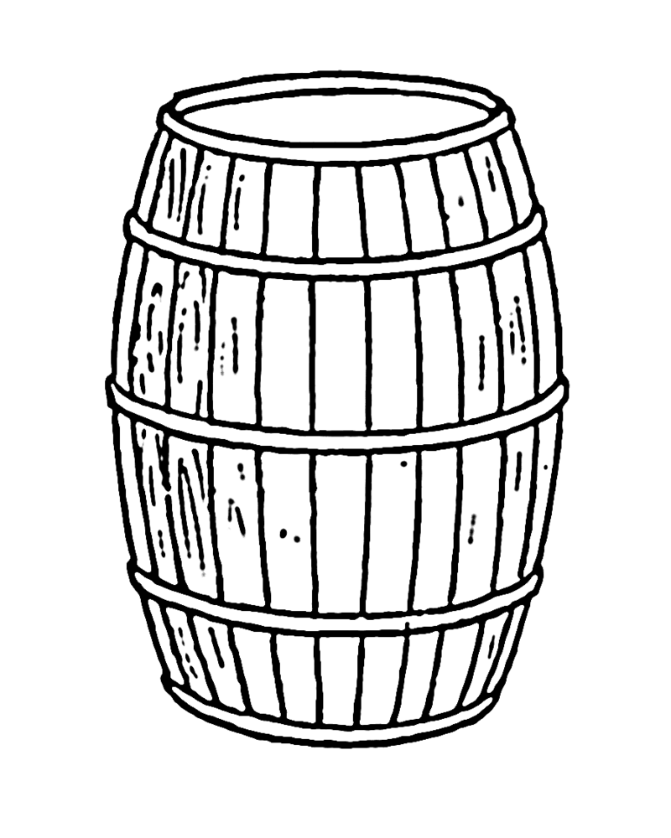


Lens Calibration: radial distortions
The three most common radial distortions
Barrel distortion
(positive radial distortion)
Pincushion distortion
(negative radial distortion)
Mustache distortion
(complex distortion)
degree 2
degree 2
degree 4

Slide 15
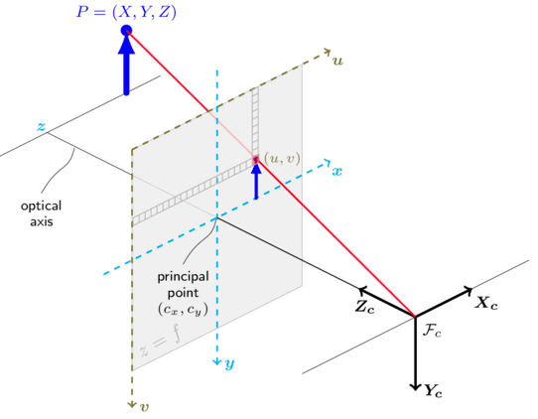
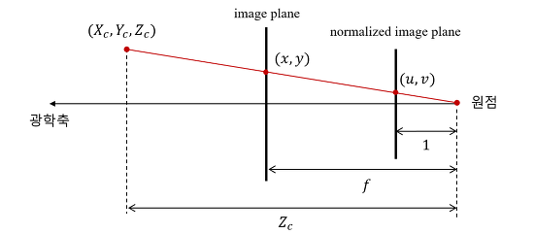
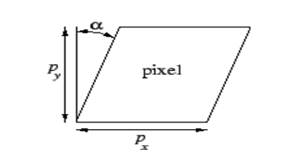
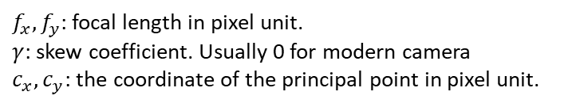
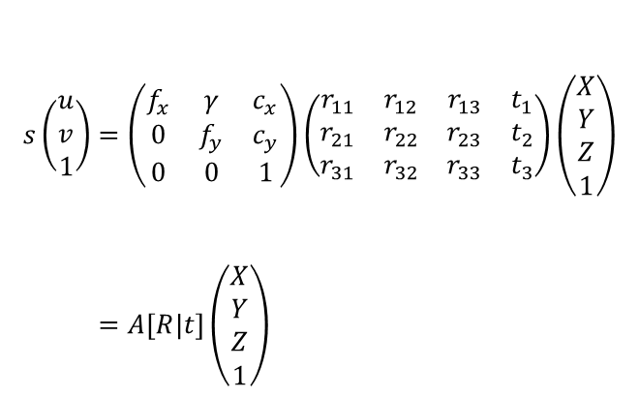


Lens Calibration: pinhole camera model
Camera matrix (Projection matrix)
$$\left(0,0,0\right)$$
optical axis
$$\left(0,0\right)$$
Image plane and
$$s\left(\begin{aligned}u \\ v \\ 1\end{aligned}\right)=\left(\begin{matrix}f_{x} & γ & c_{x} \\ 0 & f_{y} & c_{y} \\ 0 & 0 & 1\end{matrix}\right)\left(\begin{matrix}r_{11} & r_{12} & r_{13} & t_{1} \\ r_{21} & r_{22} & r_{23} & t_{2} \\ r_{31} & r_{32} & r_{33} & t_{3}\end{matrix}\right)\left(\begin{aligned}X \\ Y \\ Z \\ 1\end{aligned}\right) \\ =A\left[R|t\right]\left(\begin{aligned}X \\ Y \\ Z \\ 1\end{aligned}\right)$$
The world coordinate and the image coordinate.
$f_{x},f_{y}$: focal length in pixel unit.
$γ$: skew coefficient. Usually 0 for modern camera
$c_{x},c_{y}$: the coordinate of the principal point in pixel unit.
Skew coefficient.

Slide 16
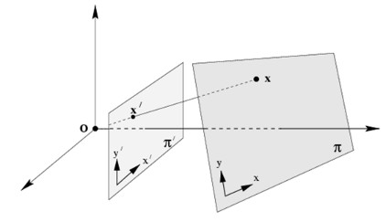
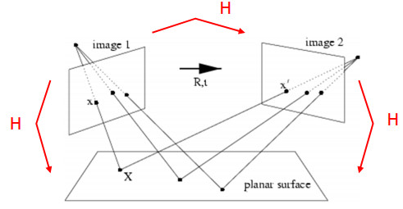
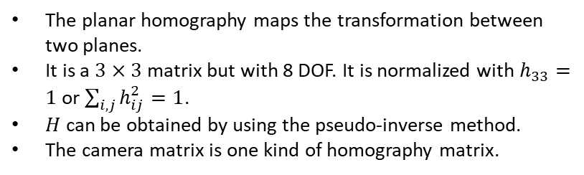
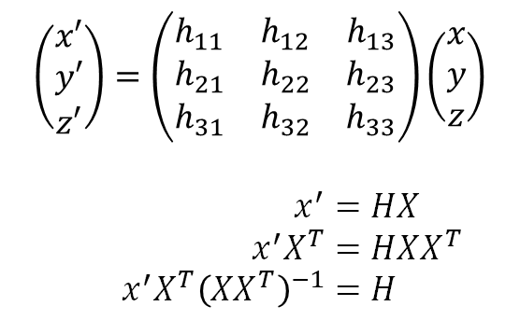

Lens Calibration
The homography matrix $H$
A planar surface and the image plane
$$\left(\begin{matrix}x′ \\ y′ \\ z′\end{matrix}\right)=\left(\begin{matrix}h_{11} & h_{12} & h_{13} \\ h_{21} & h_{22} & h_{23} \\ h_{31} & h_{32} & h_{33}\end{matrix}\right)\left(\begin{aligned}x \\ y \\ z\end{aligned}\right)$$
$$x^{′}=HX \\ x^{′}X^{T}=HXX^{T} \\ x^{′}X^{T}{\left(XX^{T}\right)}^{−1}=H$$
The planar homography maps the transformation between two planes.
It is a $3×3$ matrix but with 8 DOF. It is normalized with $h_{33}=1$ or $\sum_{i,j}{h_{ij}^{2}}=1$.
$H$ can be obtained by using the pseudo-inverse method.
The camera matrix is one kind of homography matrix.
Rotated and translated camera position

Slide 17
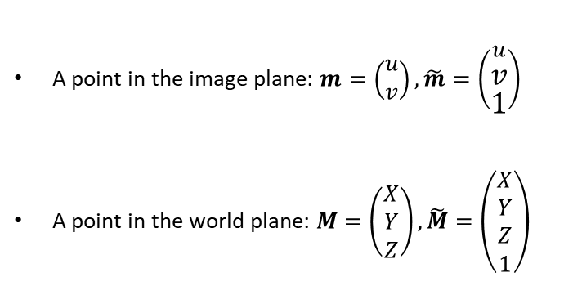
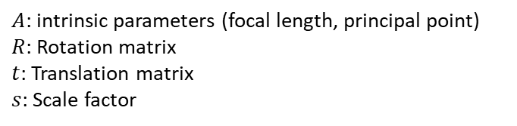
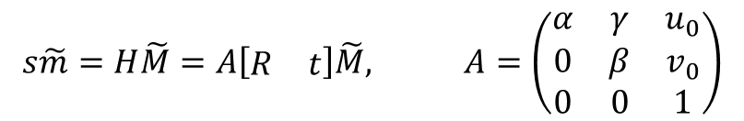
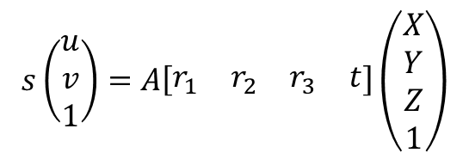
Lens Calibration
Zhengyou Zhang’s Camera Calibration method
A point in the image plane: $m=\left(\begin{aligned}u \\ v\end{aligned}\right), \tilde{m}=\left(\begin{aligned}u \\ v \\ 1\end{aligned}\right)$
A point in the world plane: $M=\left(\begin{aligned}X \\ Y \\ Z\end{aligned}\right), \tilde{M}=\left(\begin{aligned}X \\ Y \\ Z \\ 1\end{aligned}\right)$
$$s\tilde{m}=H\tilde{M}=A\left[\begin{matrix}R & t\end{matrix}\right]\tilde{M}, A=\left(\begin{matrix}α & γ & u_{0} \\ 0 & β & v_{0} \\ 0 & 0 & 1\end{matrix}\right)$$
$A$: intrinsic parameters (focal length, principal point)
$R$: Rotation matrix
$t$: Translation matrix
$s$: Scale factor
$$s\left(\begin{aligned}u \\ v \\ 1\end{aligned}\right)=A\left[\begin{matrix}r_{1} & r_{2} & r_{3} & t\end{matrix}\right]\left(\begin{aligned}X \\ Y \\ Z \\ 1\end{aligned}\right)$$

Slide 18

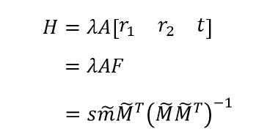
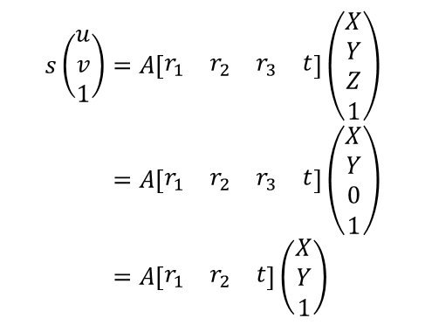


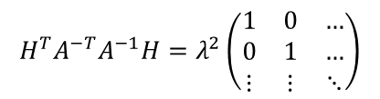
Lens Calibration
Zhengyou Zhang’s Camera Calibration method
We assume the model plane is on $Z=0$. Then,
If we dot product both side with $H^{T}A^{−T}A^{−1}$, we have
$$s\left(\begin{aligned}u \\ v \\ 1\end{aligned}\right)=A\left[\begin{matrix}r_{1} & r_{2} & r_{3} & t\end{matrix}\right]\left(\begin{aligned}X \\ Y \\ Z \\ 1\end{aligned}\right) \\ =A\left[\begin{matrix}r_{1} & r_{2} & r_{3} & t\end{matrix}\right]\left(\begin{aligned}X \\ Y \\ 0 \\ 1\end{aligned}\right) \\ =A\left[\begin{matrix}r_{1} & r_{2} & t\end{matrix}\right]\left(\begin{matrix}X \\ Y \\ 1\end{matrix}\right)$$
$$H^{T}A^{−T}A^{−1}H=H^{T}\left(A^{−T}A^{−1}H\right) \\ =H^{T}\left(λA^{−T}F\right) \\ =\left(λF^{T}A^{T}\right)\left(λA^{−T}F\right) \\ =λ^{2}F^{T}A^{T}A^{−T}F \\ =λ^{2}F^{T}F \\ =λ^{2}\left[\begin{aligned}r_{1}^{T} \\ r_{2}^{T} \\ t^{T}\end{aligned}\right]\left[\begin{matrix}r_{1} & r_{2} & t\end{matrix}\right]$$
We now have the homography matrix $H$,
$$H=λA\left[\begin{matrix}r_{1} & r_{2} & t\end{matrix}\right] \\ =λAF \\ =s\tilde{m}{\tilde{M}}^{T}{\left(\tilde{M}{\tilde{M}}^{T}\right)}^{−1}$$
Using the knowledge that $r_{1}$ and $r_{2}$ are orthonormal, we have
$$H^{T}A^{−T}A^{−1}H=λ^{2}\left(\begin{matrix}1 & 0 & … \\ 0 & 1 & … \\ ⋮ & ⋮ & ⋱\end{matrix}\right)$$
where $λ$ is an arbitrary scalar and $F=\left[\begin{matrix}r_{1} & r_{2} & t\end{matrix}\right]$.

Slide 19


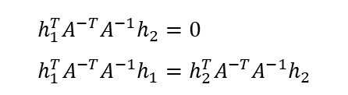


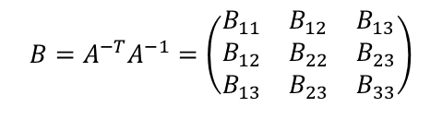
Lens Calibration
Zhengyou Zhang’s Camera Calibration method
Let’s denote $H=\left[\begin{matrix}h_{1} & h_{2} & h_{3}\end{matrix}\right]$.
Then we can readily derive that
We can get two constraints from the above equation.
$$h_{i}^{T}Bh_{j}=v_{ij}^{T}b$$
$$h_{1}^{T}A^{−T}A^{−1}h_{2}=0 \\ h_{1}^{T}A^{−T}A^{−1}h_{1}=h_{2}^{T}A^{−T}A^{−1}h_{2}$$
Inserting the above into the two constraints, they can be rewritten as,
Let $B=A^{−T}A^{−1}$. Then $B$ is symmetric.
$$\left(\begin{matrix}v_{12}^{T} \\ {\left(v_{11}−v_{22}\right)}^{T}\end{matrix}\right)b=0$$
$$B=A^{−T}A^{−1}=\left(\begin{matrix}B_{11} & B_{12} & B_{13} \\ B_{12} & B_{22} & B_{23} \\ B_{13} & B_{23} & B_{33}\end{matrix}\right)$$
Define a six-dimensional vector $b$ and $v$ such that
$$b≡{\left(\begin{matrix}B_{11} & B_{12} & B_{13} & B_{22} & B_{23} & B_{33}\end{matrix}\right)}^{T}$$
$$v_{ij}≡{\left(\begin{matrix}h_{i1}h_{j1} & h_{i2}h_{j2}+h_{i2}h_{j1} & h_{i2}h_{j2} & h_{i3}h_{j1}+h_{i1}h_{j3} & h_{i3}h_{j2}+h_{i2}h_{j3} & h_{i3}h_{j3}\end{matrix}\right)}^{T}$$
where $h_{i}={\left[\begin{matrix}h_{i1} & h_{i2} & h_{i3}\end{matrix}\right]}^{T}$ is the $i$th column of $H$.

Slide 20


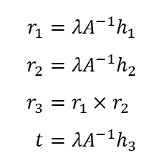


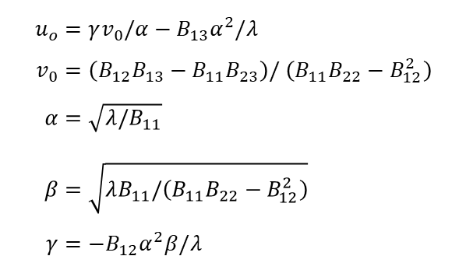


Lens Calibration
Zhengyou Zhang’s Camera Calibration method
If there are $n$ images, by stacking $n$ such equations, we have
$$u_{o}=γv_{0}/α−B_{13}α^{2}/λ \\ v_{0}=\left(B_{12}B_{13}−B_{11}B_{23}\right)/ \left(B_{11}B_{22}−B_{12}^{2}\right) \\ α=\sqrt{λ/B_{11}} \\ β=\sqrt{λB_{11}/\left(B_{11}B_{22}−B_{12}^{2}\right)} \\ γ=−B_{12}α^{2}β/λ$$
$$Vb=0$$
where $V$ is a $2n×6$ matrix.
Solution: eigenvectors of $V^{T}V$ with the smallest eigenvalues.
$$V^{T}Vb=0$$
where ${\left(V^{T}V\right)}^{−1}$ is not exist.
Once the intrinsic parameters are obtained, the extrinsic parameters for each image are readily computed.
When $n≥3$, $b$ is obtained and then $B$ is known.
Since $H=λA\left[\begin{matrix}r_{1} & r_{2} & t\end{matrix}\right]$,
$$r_{1}=λA^{−1}h_{1} \\ r_{2}=λA^{−1}h_{2} \\ r_{3}=r_{1}×r_{2} \\ t=λA^{−1}h_{3}$$
$$b→B→A→α,β,γ,u_{0},v_{0}$$
All the intrinsic parameters are obtained.

Slide 21
Lens Calibration
OpenCV python test code: Spot searching
Before
After

Slide 22
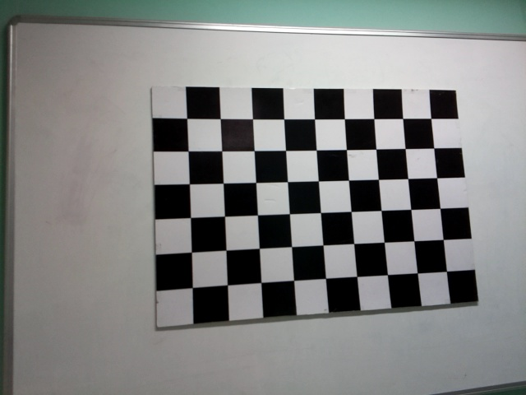
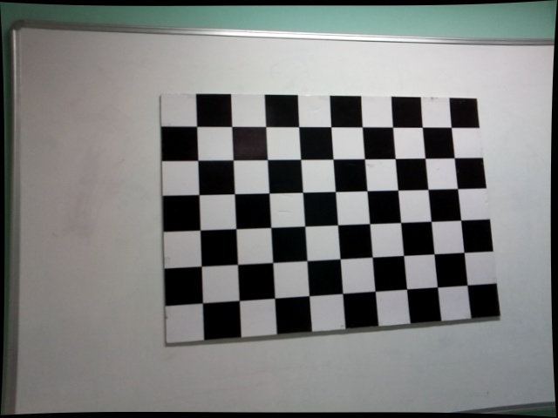
Lens Calibration
OpenCV python test code: Undistort the image
Before
After
Barrel distortion

Slide 23
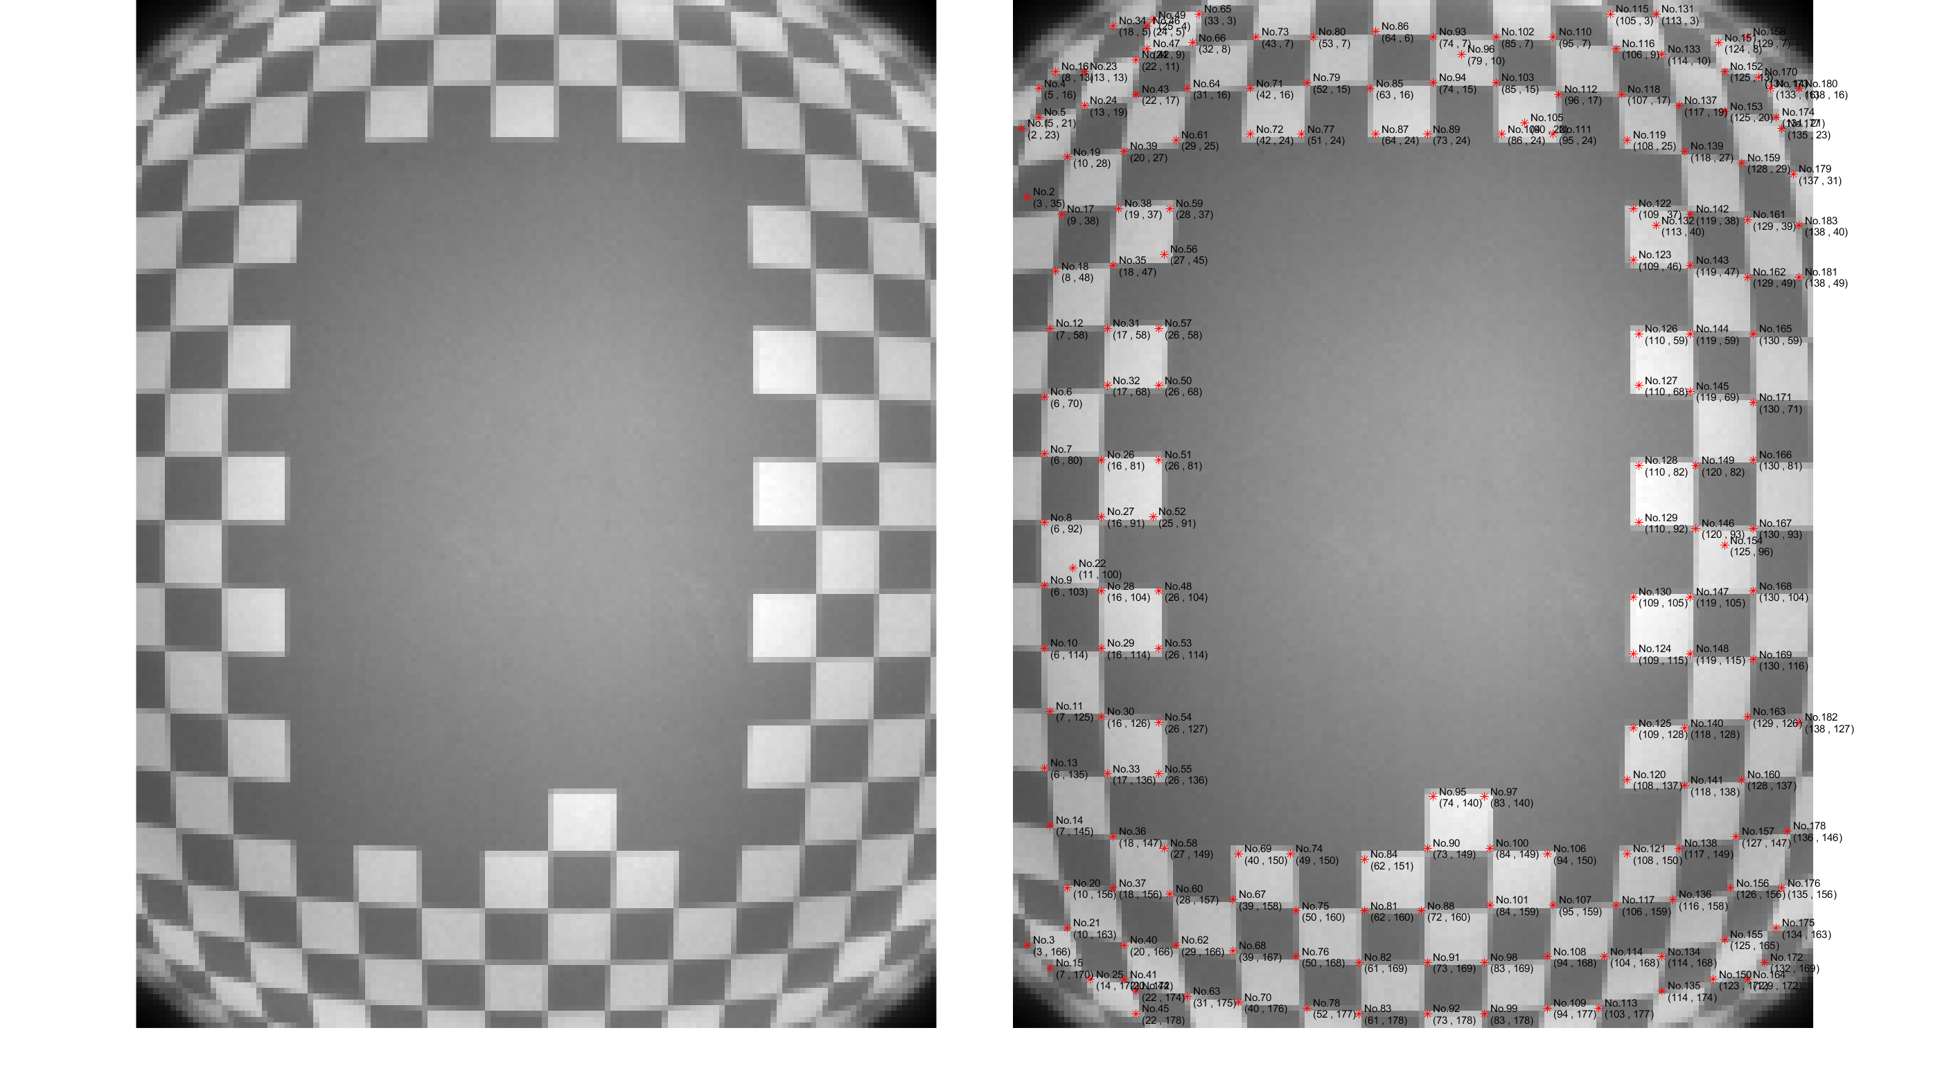
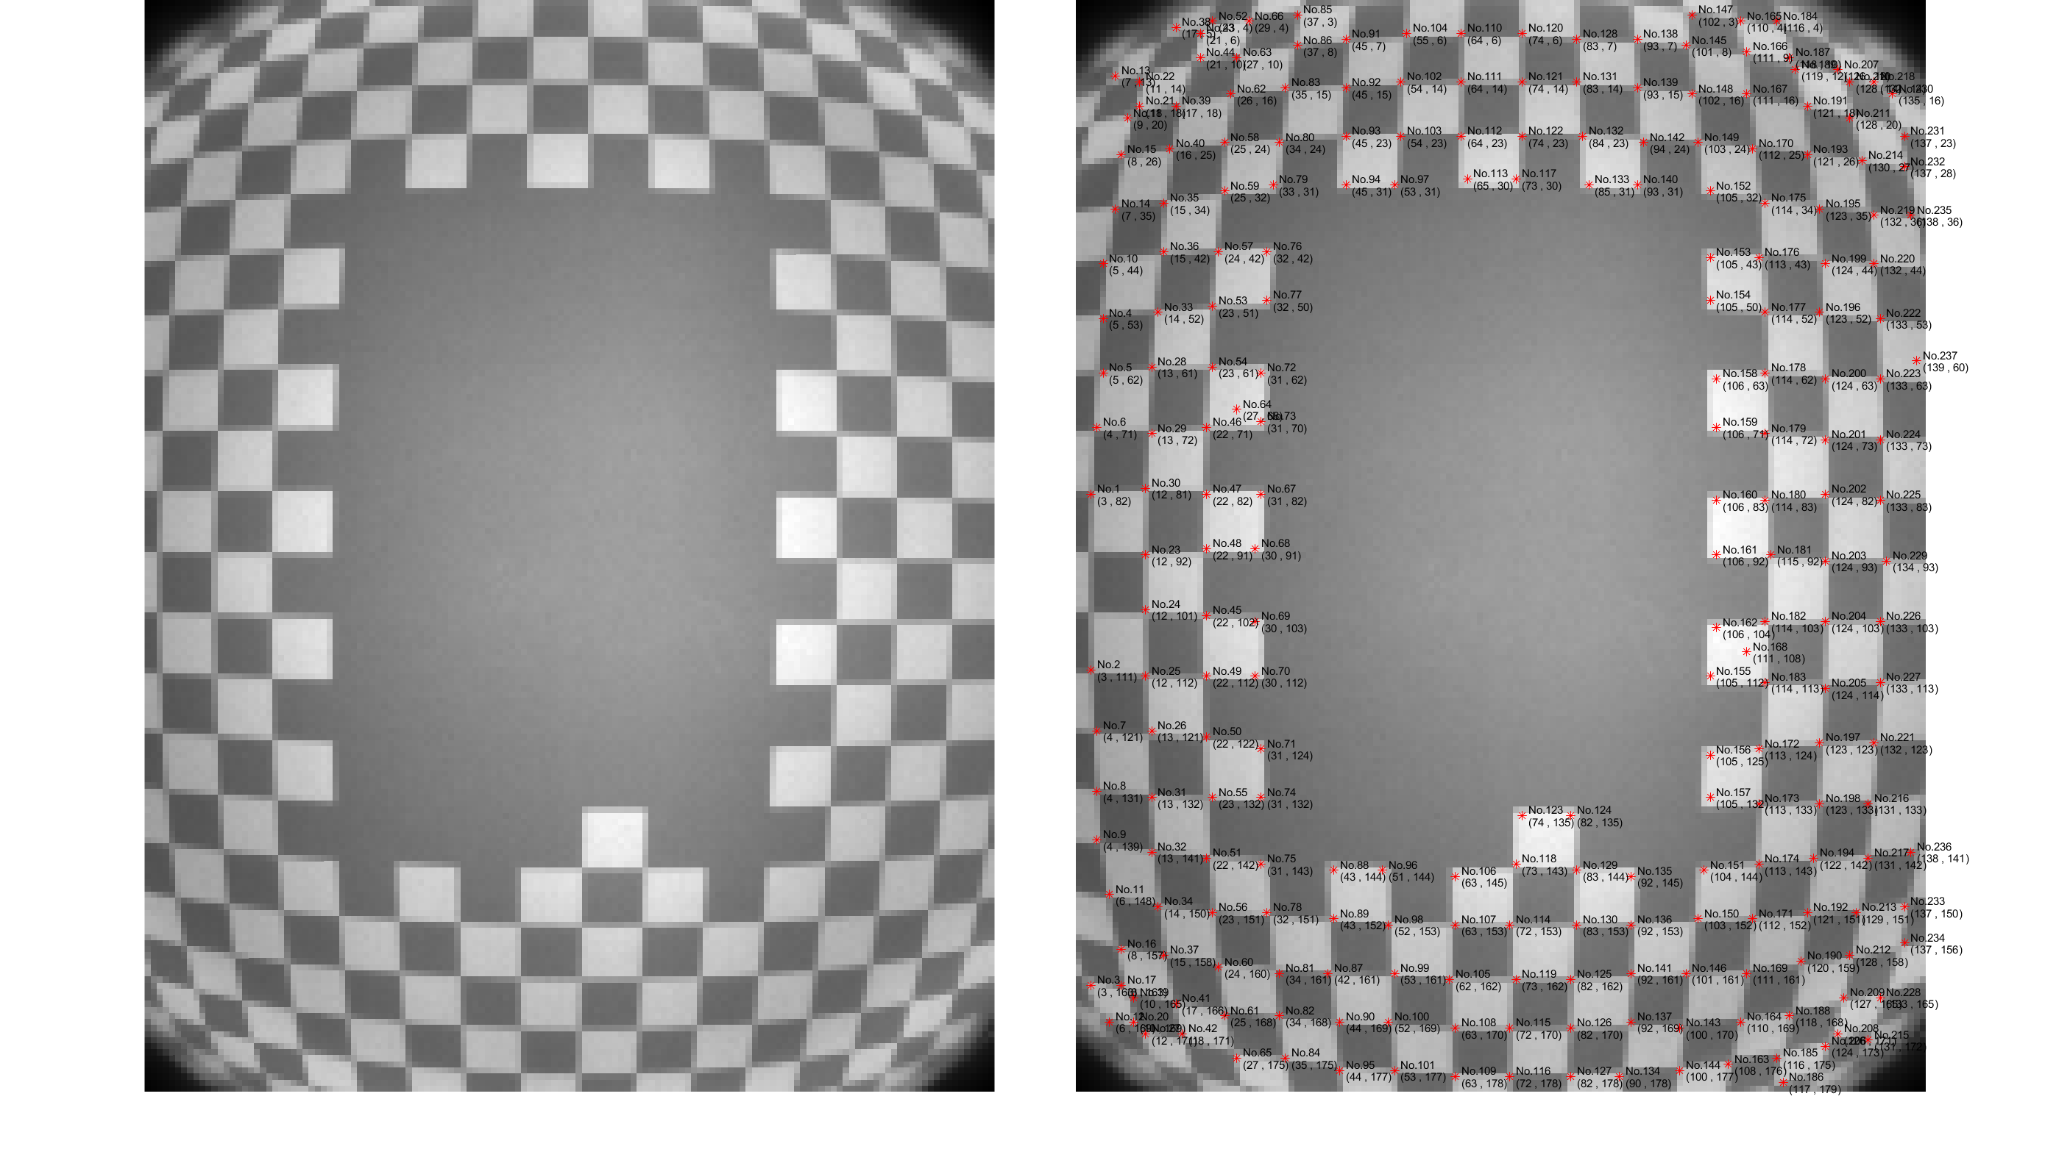
Lens Calibration
Lens Calibration in Jasper
80cm
90cm
100cm

Slide 24
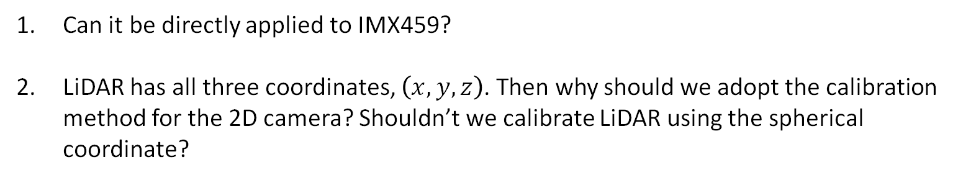
Lens Calibration
Can it be directly applied to IMX459?
LiDAR has all three coordinates, $\left(x,y,z\right)$. Then why should we adopt the calibration method for the 2D camera? Shouldn’t we calibrate LiDAR using the spherical coordinate?

